Slide 1
Elementary Education By State Report 2016-17
Contributor:
Tejas Jaiswal
Milind Raut
Sakshi Sahara
Piyush shelode
Vrushabh gavande
Shubham dubey
Mukul Sheware
Project guide: Rashmi Joshi mam

Slide 2
Introduction
We have used the data set of Indian education ministry.
The dataset details of Indian state in education sector.
Every year education ministry share this dataset and We have dataset of 2016-17.
We divided our analysis in various category.
Brief overview of the purpose and significance of the elementary state report card raw data for the 2016-17 academic year.
Importance of analyzing and understanding the data for educational policy-making, school improvement, and academic research.
This dataset contain 37 rows and 436 columns.

Slide 3
Data sources overview
Data Reported from: state name, no. districts, villages and cluster.
Basic data of state census from 2011: It Contains Total population state-wise, caste-wise, growth rate, sex ratio, literacy rate.
School by Category: Also Government and private school data differently
School with different types of facility like playground, boundary wall, girl’s-Boys toilet, drinking water, electricity, computer, ramp and mid-day meal.
Data of teacher’s in various category’s.

Slide 4
Elementary-2 sheet contains data of student and teachers enrolment in school by category
Category are – grade-wise, state-wise, cast-wise
Total Classrooms, other rooms.
Incentives primary and Incentives upper primary
We also have dataset of year 2015-16
Which includes total school by category, category of school by facility and teachers by school category.

Slide 5
INDEX
Key Insights -by Milind
Data Cleaning -by Milind
Statistic -by Milind
Analysis of School Facility -by Sakshi
Analysis of Student Grades -by Shubham
Analysis of category of Teachers -by Piyush
Analysis of 2 year data (2015-16 to 2016-17) -by Tejas
Conclusion

Slide 6
Key Insights-Obtained-Education data analysis
Understand enrollment growth trends and demographic shifts
Identify infrastructure gaps across states - electricity, playgrounds, computers etc.
Analyze differences in literacy rate by gender, social status and school types
Evaluate student-teacher ratios and training needs
Compare quality of education indicators across rural and urban schools
Correlate school facilities with educational outcomes
Project future enrollment and infrastructure needs
Inform policy decisions on teacher hiring and training
Guide resource allocation to improve literacy rates
Develop plans to improve access and quality of education

Slide 7
DATA CLEANING
Data cleaning is - the process of detecting and correcting corrupt or inaccurate records from a data set.
Importance of data cleaning - improves data quality, provides accurate insights, avoids errors in analysis
Some of the steps I took are :
Tools for data cleaning- Excel
Get a sense of the data contents, structure, formats etc.
Identify fields, data types, any headers, footers etc.
Identify missing values-(Not Found), duplicates(Not Found), formatting problems-(Resolve)
Check : “Elementary_1” Null values in all Columns and found None,
56 Main Column Found, 429 Branch Of main column found, 435 Overall column (NA year).
“Elementary_2” Null values in all Columns and found None,
29 Main Column Found, 348 Branch Of main column found, 384 Overall column (NA year).
“Elementary_Previous_Year” Null values in all Columns and found None,
31 Main Column Found, 236 Branch Of main column found, 254Overall column (NA year).

Slide 8
DESCRIPTIVE STATISTICS OF DATASET
Mean: Average value of the data points.
Median: Middle value of the dataset when it's sorted.
Mode: Most frequently occurring value.
Max: Maximum Value.
Min: Minimum Value.
Range: Difference between the maximum and minimum values.
Variance: Measure of how spread out the values are.
Standard Deviation: Measure of the amount of variation or dispersion in a set of values.
Count: Total number of data points.

Slide 9
DESCRIPTIVE STATISTICS
Particulars | Projected Population | Total Schools | Total Enrolment by School | Schools Established Since 2001 | Total Teachers by School
Average / Mean | 2819189.847 | 40768.88889 | 5274639.306 | 12475.77778 | 77065.03704
Median | 1503639.5 | 23209 | 3406701.5 | 5406 | 19568
Mode | #N/A | #N/A | #N/A | #N/A | 0
Max | 27421871 | 254204 | 34707745 | 116473 | 584133
Min | 3805 | 41 | 7278 | 10 | 0
Range | 27418066 | 254163 | 34700467 | 116463 | 584133
variance | 19040850128161.90 | 2732285739 | 52747401883375.30 | 441822735.3 | 16680189788
Standard Deviation | 4363582.259 | 52271.27069 | 7262740.659 | 21019.57981 | 131056.5867
Count | 72 | 36 | 36 | 36 | 84

Slide 10
Analysis of School Facility

Slide 12
Analysis of Student Grades

Slide 14
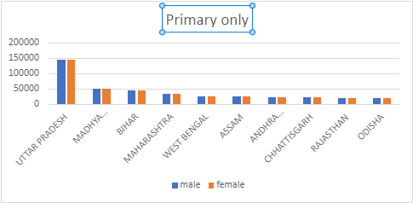
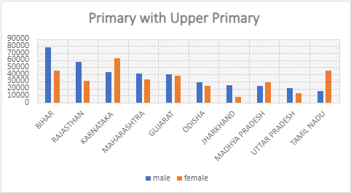
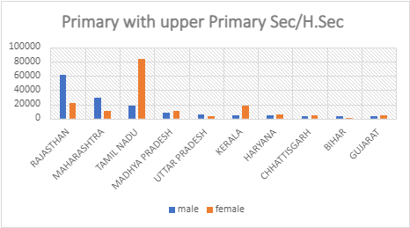
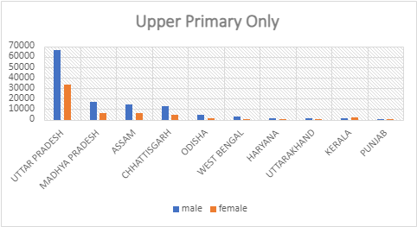
Analysis of category of Teachers

Slide 16
Analysis of 2 year data (2015-16 to 2016-17)

Slide 18
TOP 10 STATES

Slide 21
Conclusion
In reviewing the elementary state report card data for 2016-17, it's clear that while there are notable successes, there are also areas needing attention. By using this data to inform targeted interventions and policies, we can work towards a more equitable and effective education system. Let's commit to leveraging data-driven decision-making to ensure every child has the opportunity to succeed."

